Slide 1


JavaScript Basics
Object
Array

Slide 2
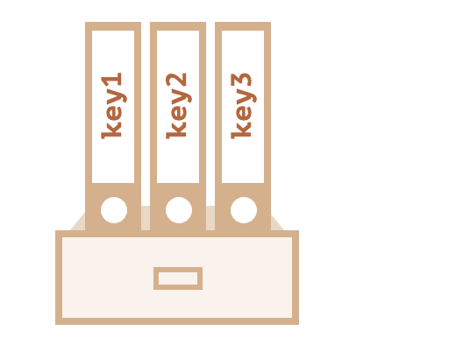
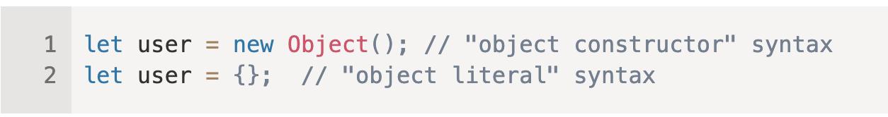
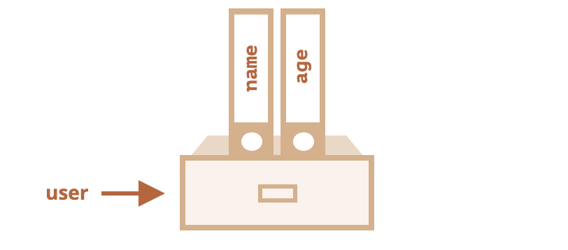
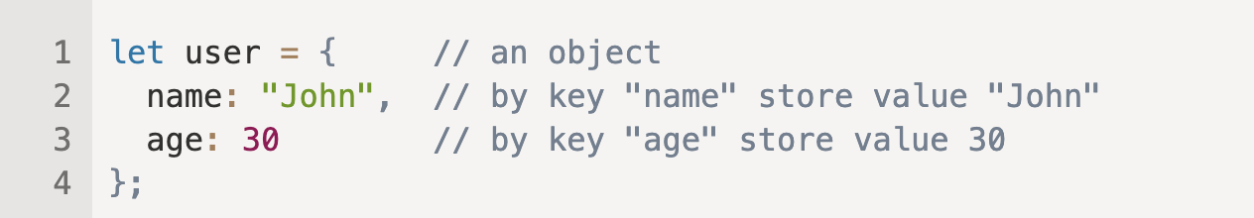
Objects
In JavaScript, an object is an unordered collection of key-value pairs.
Each key-value pair is called a property. The key of a property can be a string.
And the value of a property can be any value, e.g., a string, a number, an array, and even a function.

Slide 3
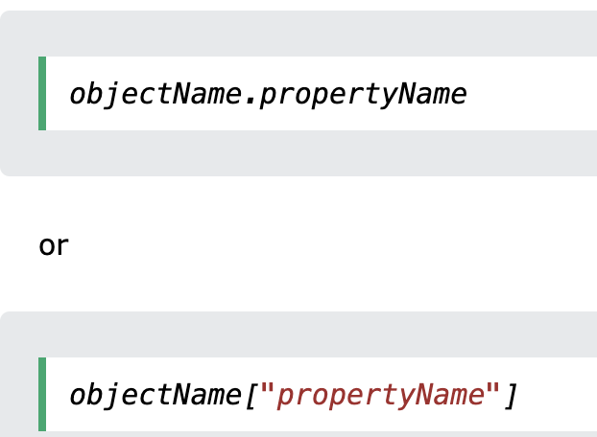
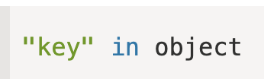
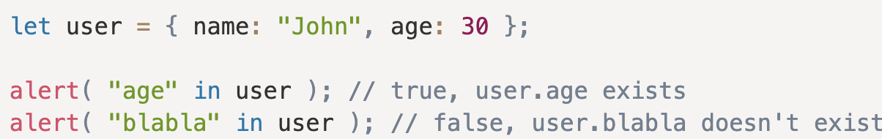
Accessing Object Properties

Slide 4
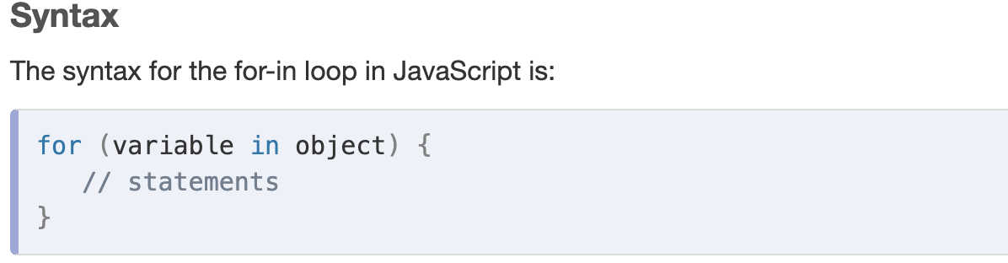
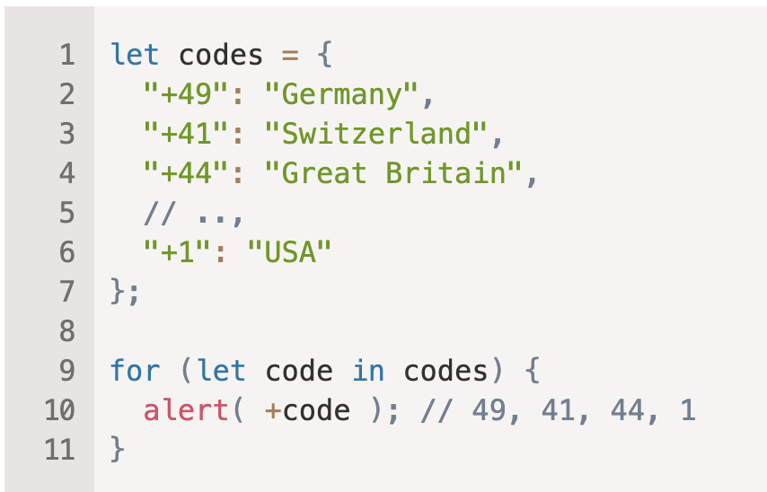
For In Loop

Slide 5





Object Methods

Slide 6
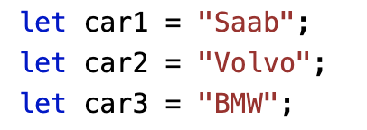
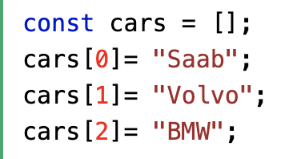

Arrays

Slide 7
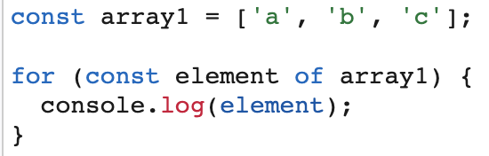
Array Methods

Slide 8
Tasks
Write the function isEmpty(obj) which returns true if the object has no properties, false otherwise.
Write a JavaScript function to clone an array
Write function which finds max value of array.
Write function which receive an array and return 2 arrays 1 for odd 1 for even.
Write a JavaScript program which return array of elements count.
[[1, 2, 1, 24], [7, 11, 9], [7, 4 ]]
[28, 27, 11]
Write function which filter all persons which are admins.
Write functions which calculates all salaries for admins.
Write function which return salaries total for every currency.
{
name: “John”,
isAdmin: true,
salary: 180,
currency: “USD”
}

